Slide 1
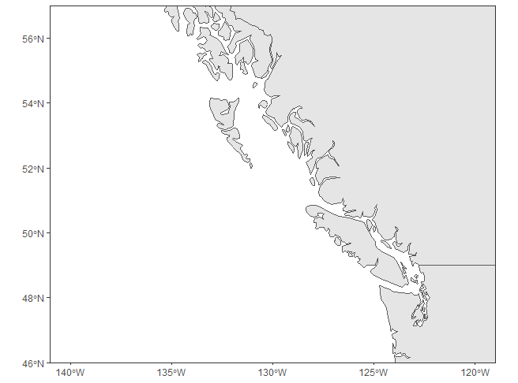
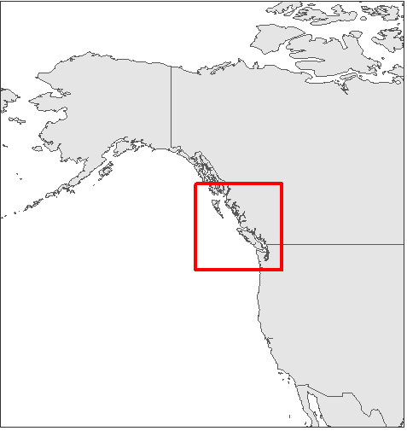

Latitude
Longitude

Slide 2
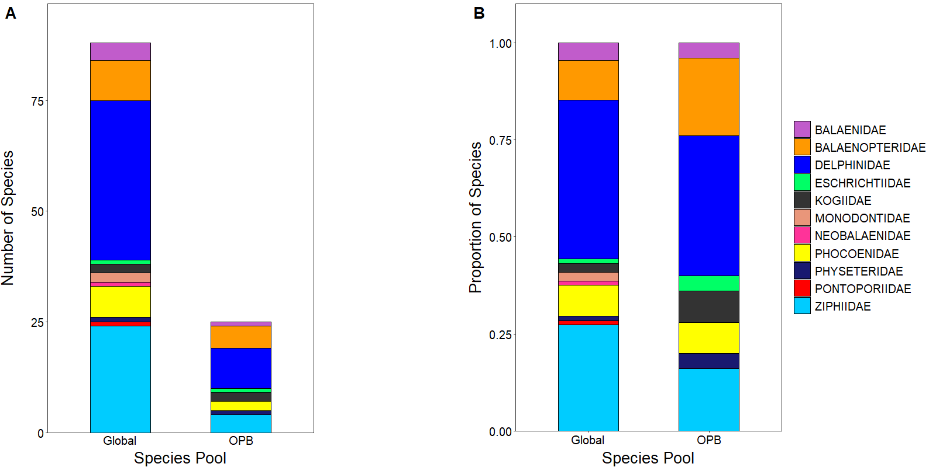

Slide 3
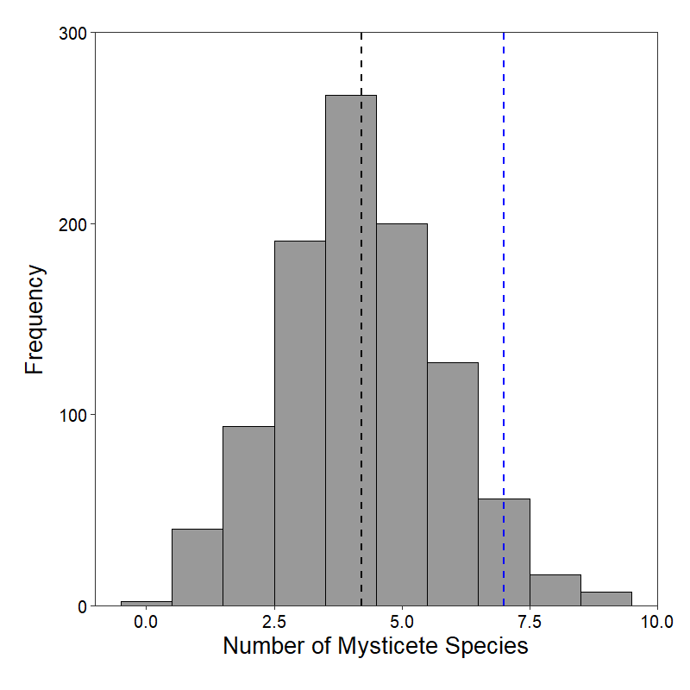
Mean = 4.21
OPB = 7.00
SES = 1.74

Slide 4
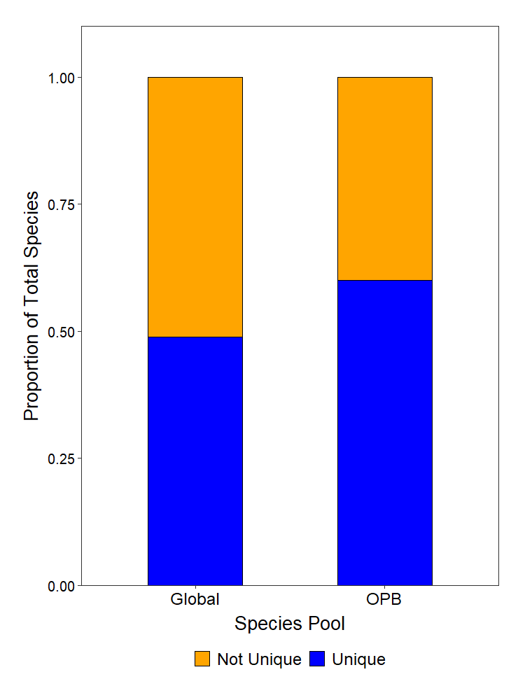

Slide 5
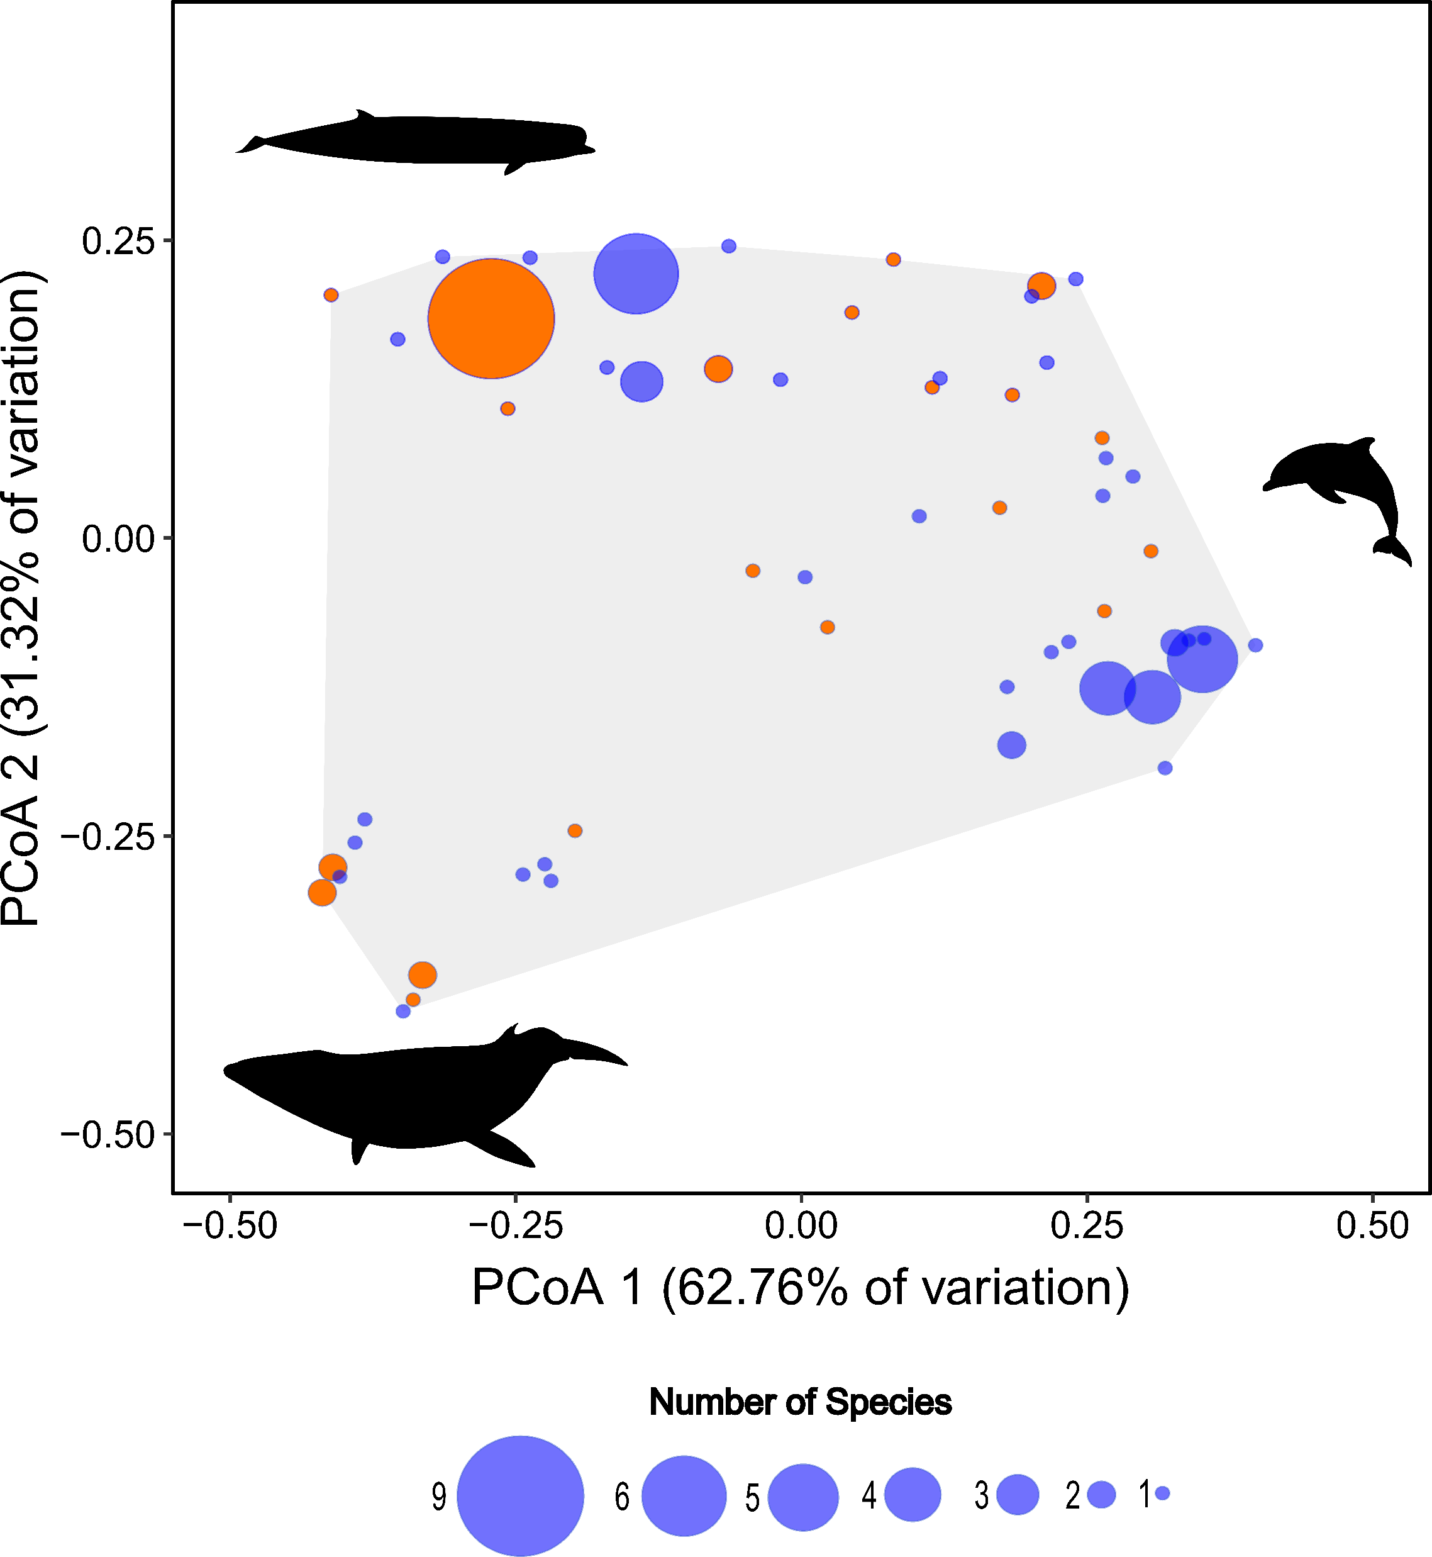

Slide 6
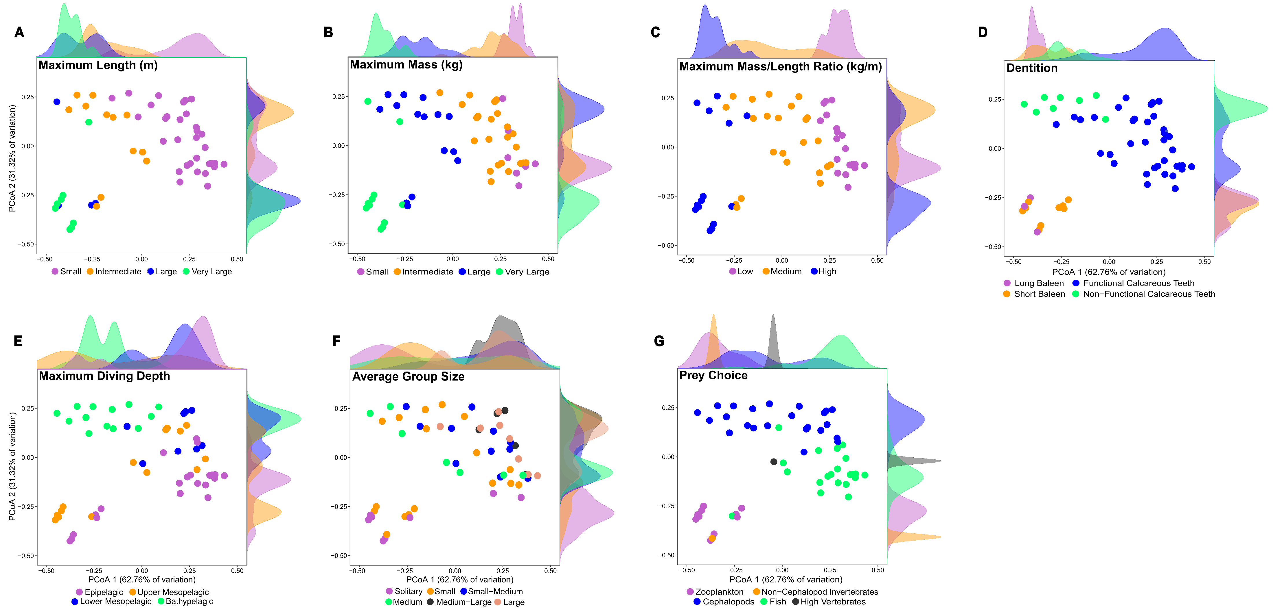

Slide 7
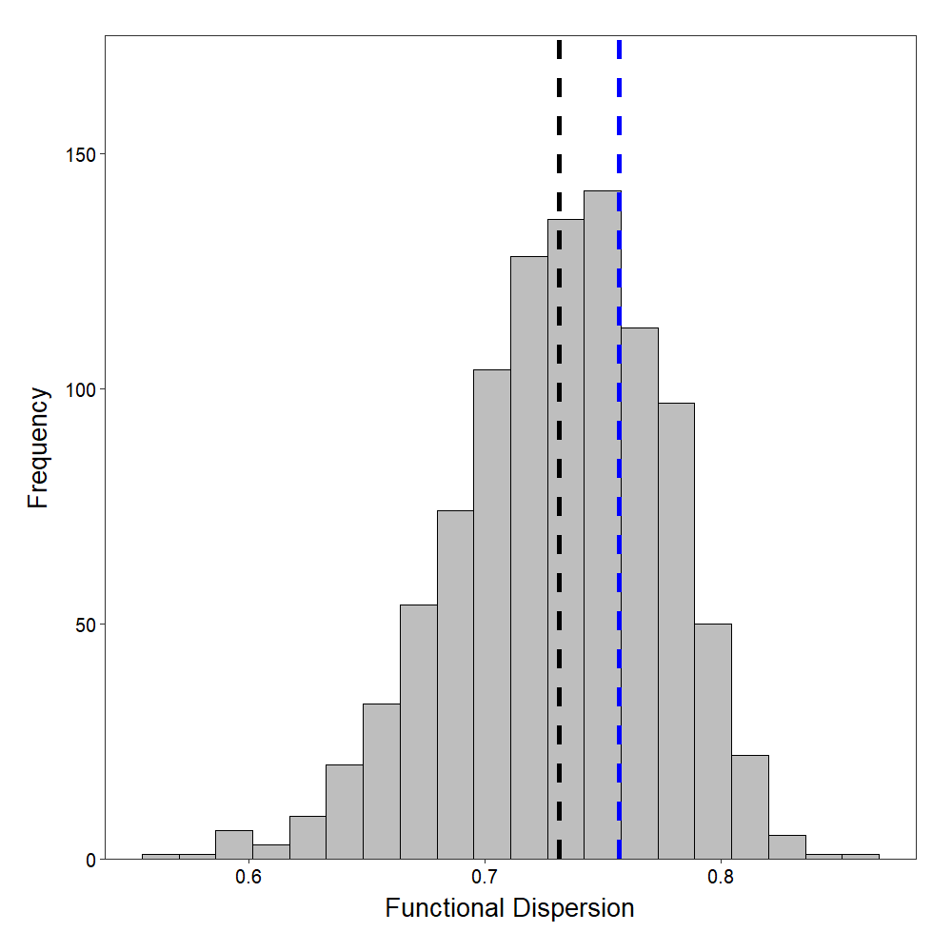
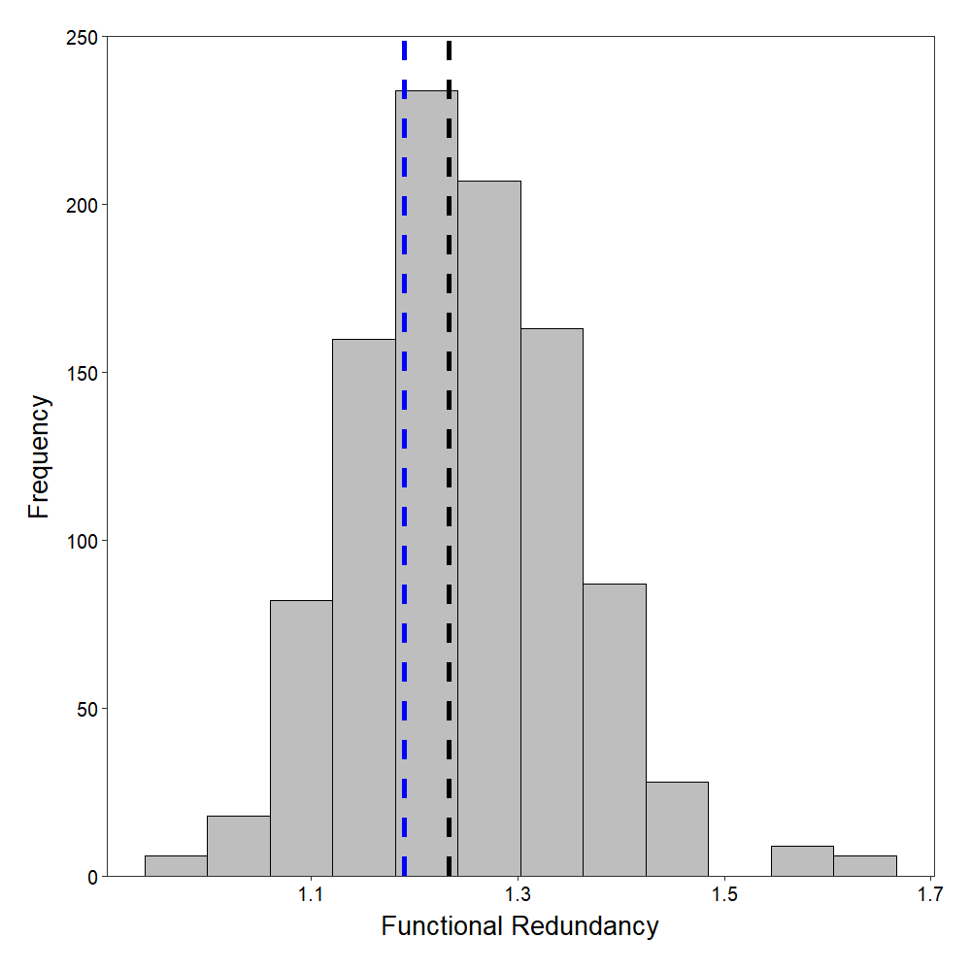
Mean = 0.73
OPB = 0.76
SES = 0.58
Mean = 1.23
OPB = 1.19
SES = -0.40

Slide 8
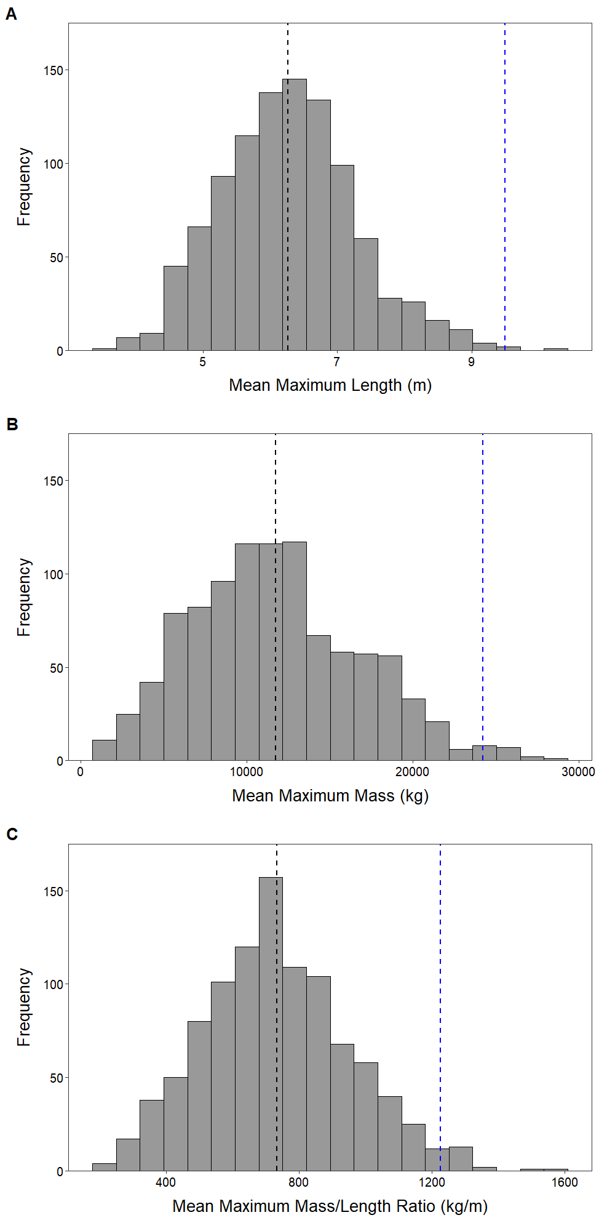
Mean = 6.27 m
OPB = 9.50 m
SES = 3.23
Mean = 11746 kg
OPB = 24254 kg
SES = 2.48
Mean = 734 kg/m
OPB = 1227 kg/m
SES = 2.24

Slide 9
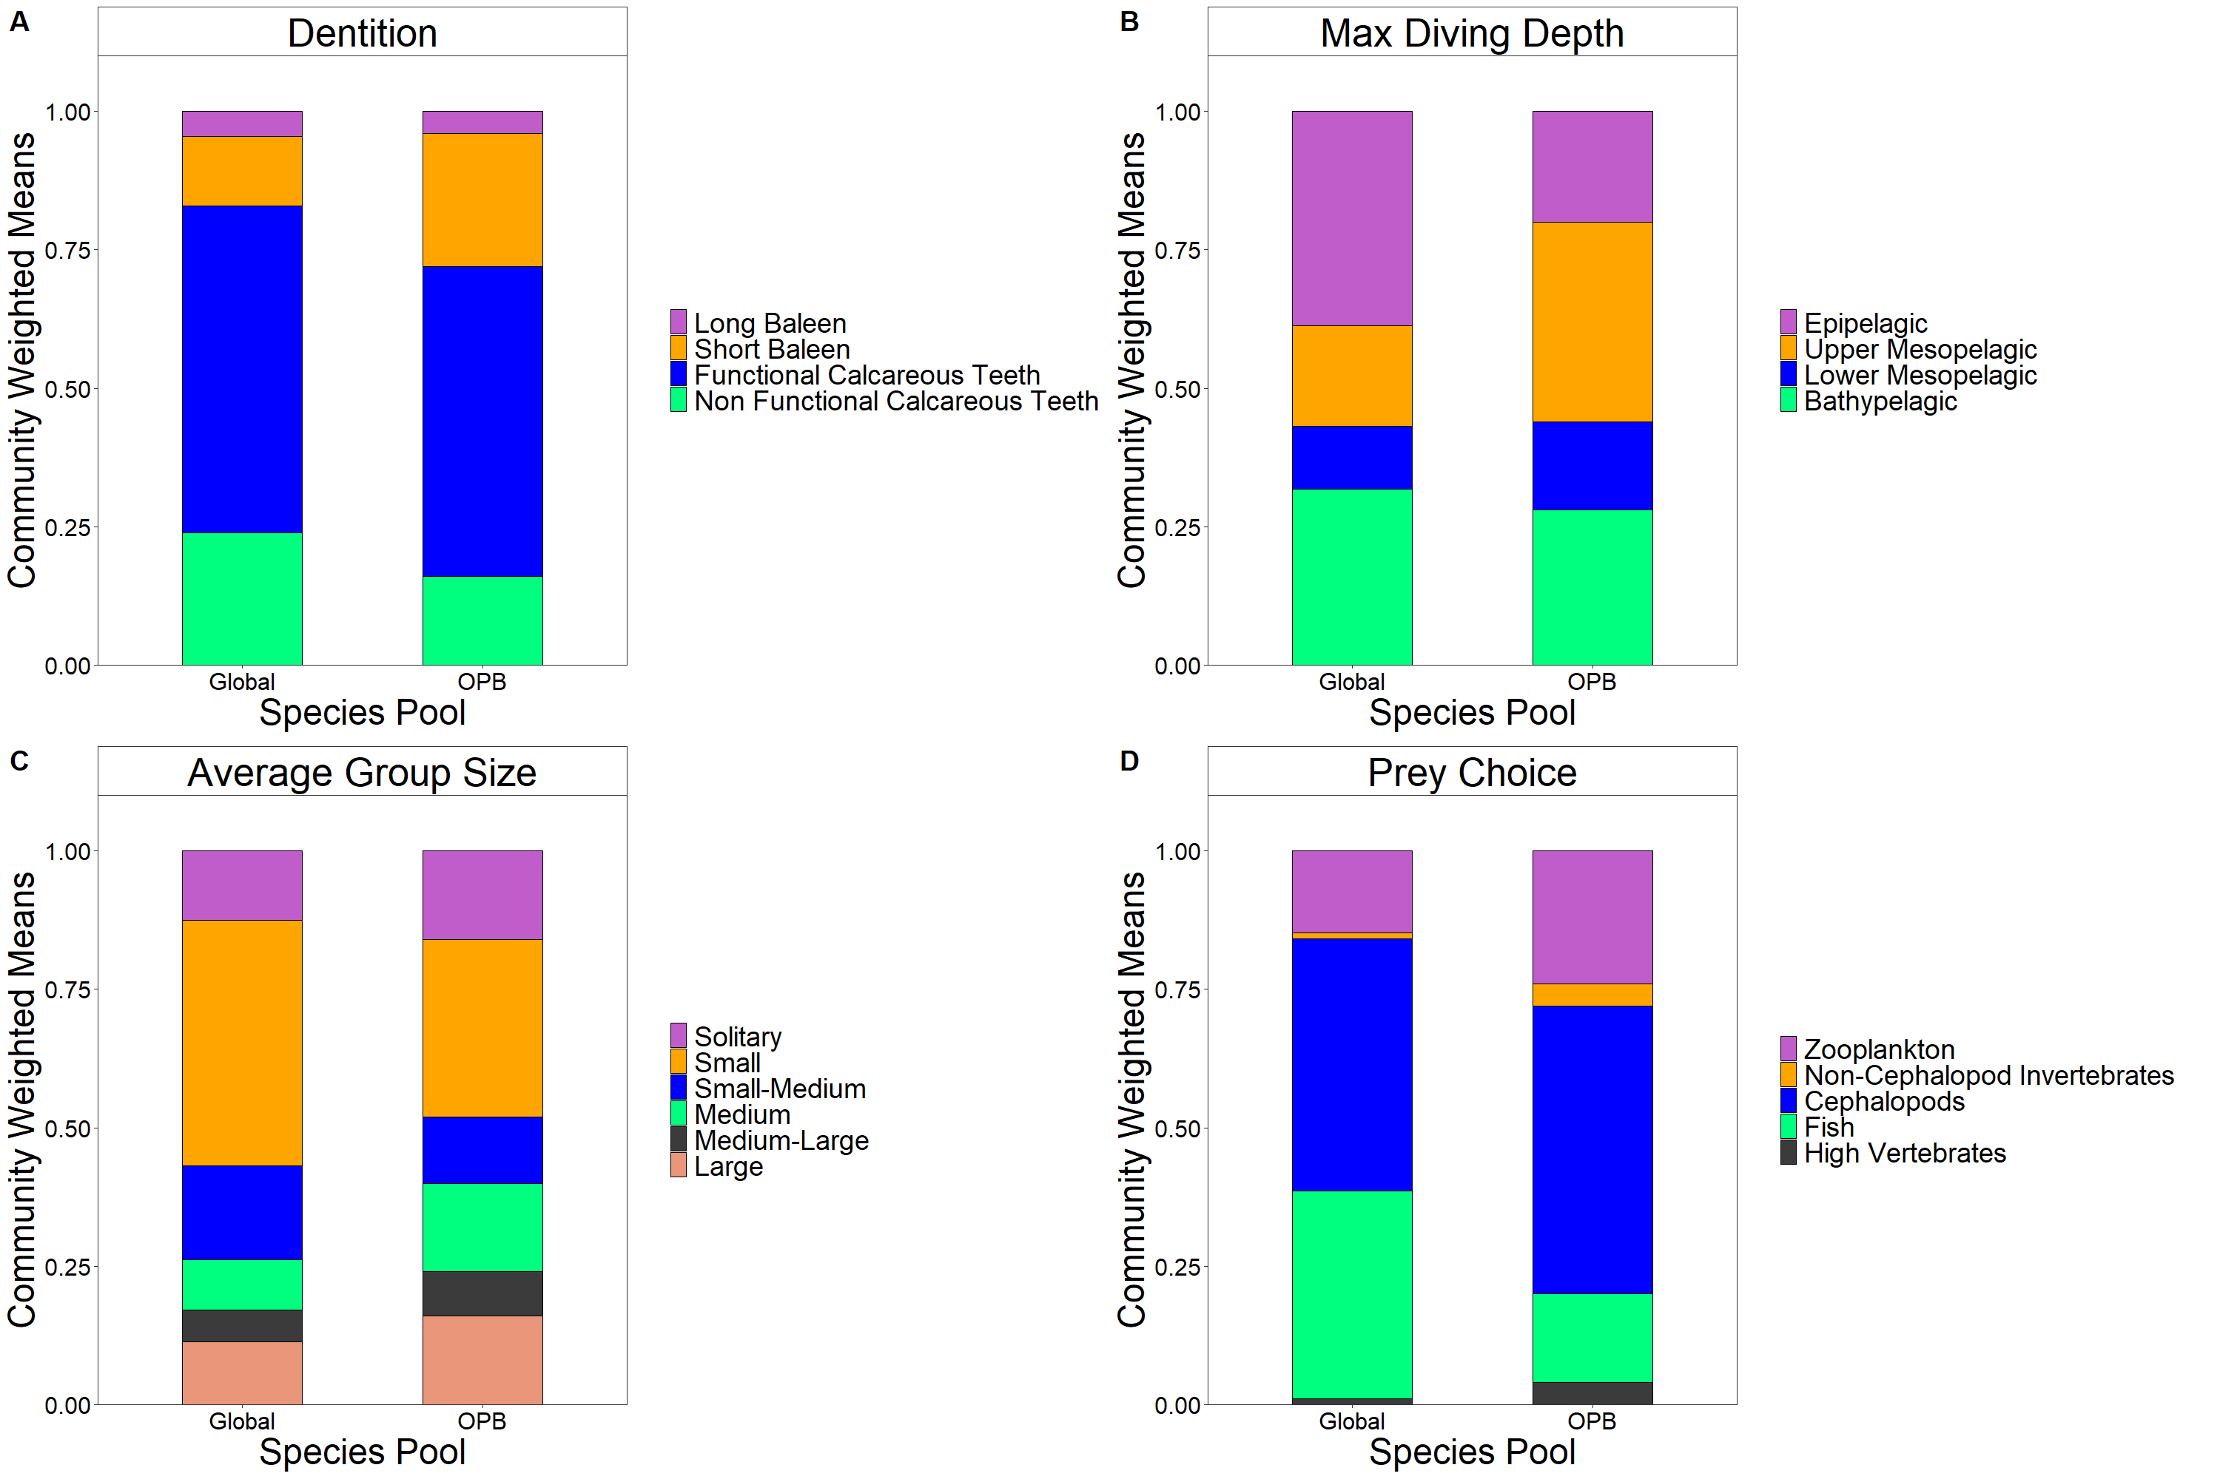

Slide 10
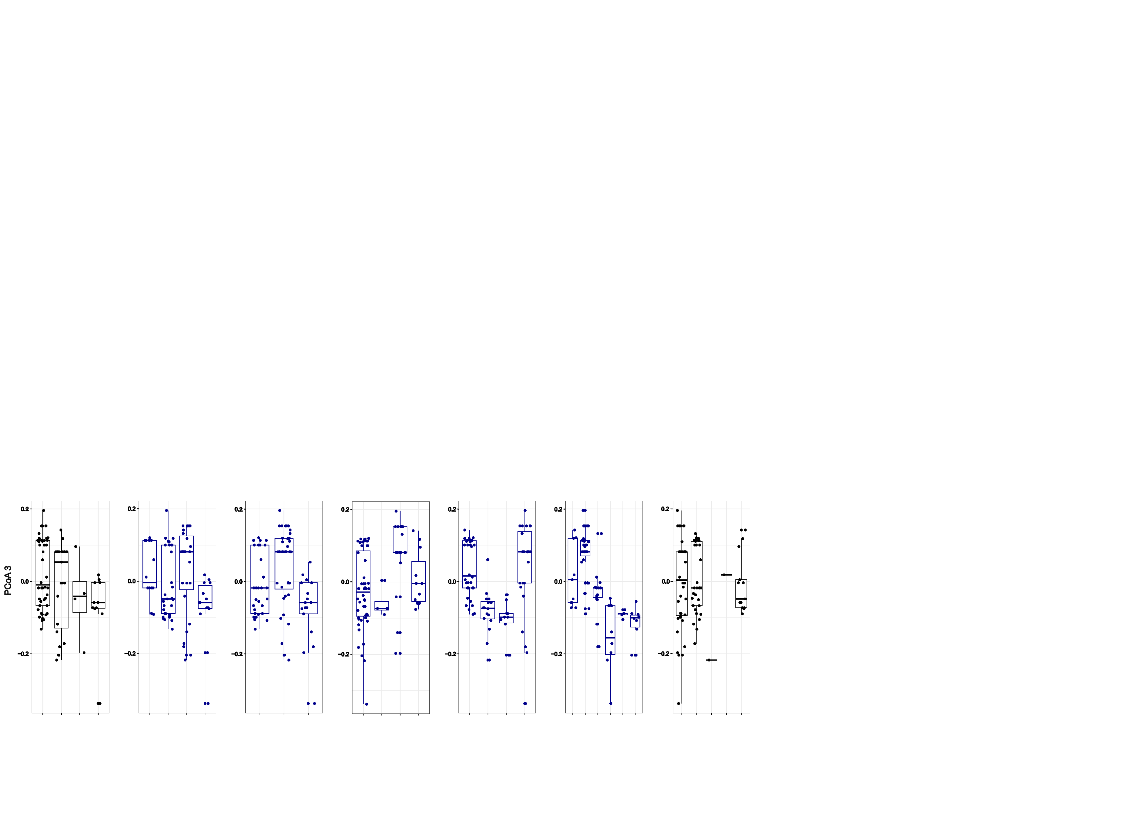
Max. Length Max. Mass Mass/Length Dentition
Small Medium Large Very Large
Small Medium Large Very Large
Low Medium High
FCT LB NFCT SB
Max. Diving Depth Average Group Size Prey Choice
EP UM LM BP
Sol. S S-M M M-L L
C F NCI HV Z

